Slide 1
Compiler Design

Slide 2
Course Outline
Aspects of Compilation
Phases of compilation
Scanning and Parsing
Compilation of Expressions,
Compilation of Control Structures Code Generation and Code optimization techniques
Compiler Writing Tools

Slide 3
COMPILERS
A compiler is a system software takes a program written in a source language and translates it into an equivalent program in a target language.
source program COMPILER target program
error messages
As an important part of translation process, the compiler report to its user the presence of error in the source program.
( Normally the equivalent program in
machine code – relocatable object file)
( Normally a program written in
a high-level programming language)

Slide 4
Abstract view
Source
code
Compiler
Machine
code
errors
Recognizes legal (and illegal) programs
Generate correct code
Manage storage of all variables and code
Agreement on format for object code

Slide 5
Continue..
Compilers are sometimes classified as
single-pass
multi-pass
debugging or optimizing, depending on how they have been constructed or what function they are supposed to perform.
If we combine or group all the phases of compiler design in a single module known as single pass compiler.
Single pass compiler is one that processes the input exactly once, so going directly from lexical analysis to code generator.
Single pass compiler is faster and smaller than the multi pass compiler

Slide 6
Continue..
As a disadvantage of single pass compiler is that it is less efficient in comparison with multi-pass compiler.
A Two pass/multi-pass Compiler is a type of compiler that processes the source code or abstract syntax tree of a program multiple times.
In first pass, included phases are as Lexical analyzer, syntax analyzer, semantic analyzer, intermediate code generator are work as front end
Analytic part means all phases analyze the High level language and convert them three address code.
First pass is platform independent because the output of first pass is as three address code which is useful for every system and requirement is to change the code optimization and code generator phase which are comes to the second pass.

Slide 7
Continue..
In second Pass the included phases are as Code optimization and Code generator are work as back end
Second pass is platform dependent because final stage of a typical compiler converts the intermediate representation of program into an executable set of instructions which is dependent on the system.

Slide 8
Other Applications
In addition to the development of a compiler, the techniques used in compiler design can be applicable to many problems in computer science.
Techniques used in a lexical analyzer can be used in text editors, information retrieval system, and pattern recognition programs.
Techniques used in a parser can be used in a query processing system such as SQL.
Many software having a complex front-end may need techniques used in compiler design.
Most of the techniques used in compiler design can be used in Natural Language Processing (NLP) systems.

Slide 9
Practical applications
Greedy algorithms - register allocation
Heuristic search - list scheduling
Graph algorithms - dead code elimination, register allocation
Dynamic programming - instruction selection
Optimization techniques – instruction scheduling
Finite automata – lexical analysis
Pushdown automata – parsing
Complex data structure – symbol table, data dependence graph
Computer architecture – machine code generator

Slide 10
Major Parts of Compilers
There are two major parts of a compiler: Analysis and Synthesis
In analysis phase, an intermediate representation is created from the given source program.
Lexical Analyzer, Syntax Analyzer and Semantic Analyzer are the parts of this phase.
In synthesis phase, the equivalent target program is created from this intermediate representation.
Intermediate Code Generator, Code Generator, and Code Optimizer are the parts of this phase.

Slide 11
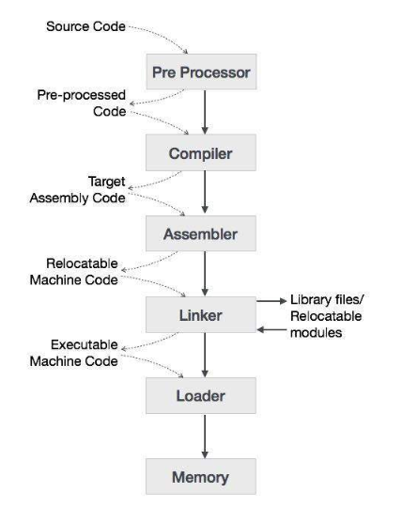
Language processing system

Slide 12
Phases of A Compiler
Source
Program
Lexical
Analyzer
Syntax
Analyzer
Semantic
Analyzer
Intermediate
Code Generator
Code
Optimizer
Code
Generator
Target
Program
Each phase transforms the source program from one representation
into another representation.
They communicate with error handlers.
They communicate with the symbol table.

Slide 13
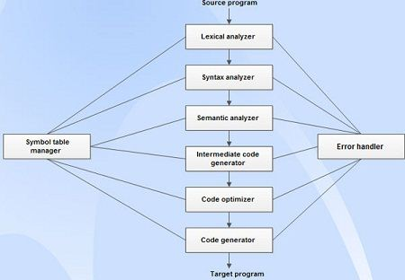

Slide 14
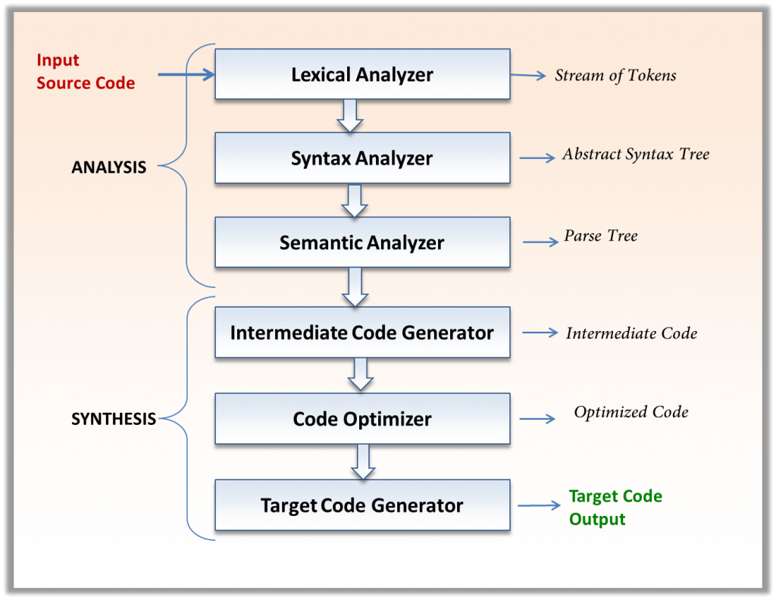

Slide 15
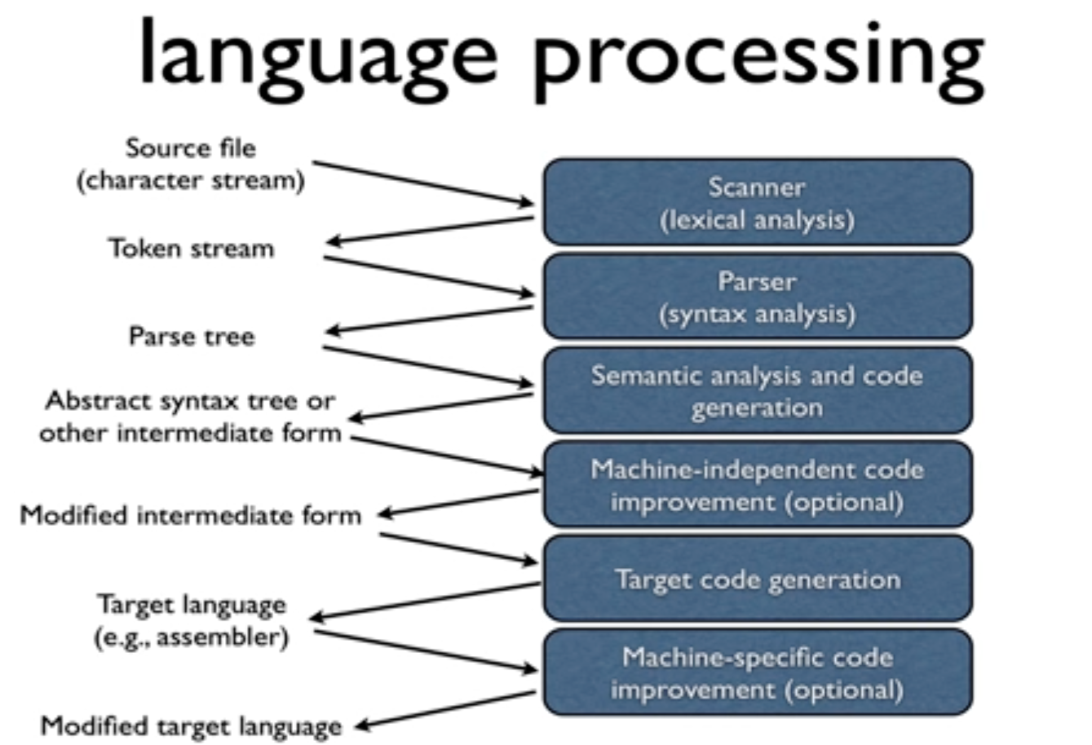
Continue..

Slide 16
Lexical Analyzer
Lexical Analysis is the first phase of compiler also known as scanner.
Its main task is to read the input characters and produce as output a sequence of tokens that the parser use for syntax analysis.
It converts the High level input program into a sequence of Tokens.
Lexical Analysis can be implemented with the Deterministic finite Automata
Example of token:
Keywords; Examples-for, while, if etc.
Identifier; Examples-Variable name, function name etc.
Operators; Examples '+', '++', '-' etc.
Separators; Examples ',' ';' etc
Example of Non-Tokens:
Comments, preprocessor directive, macros, blanks, tabs, newline etc

Slide 17
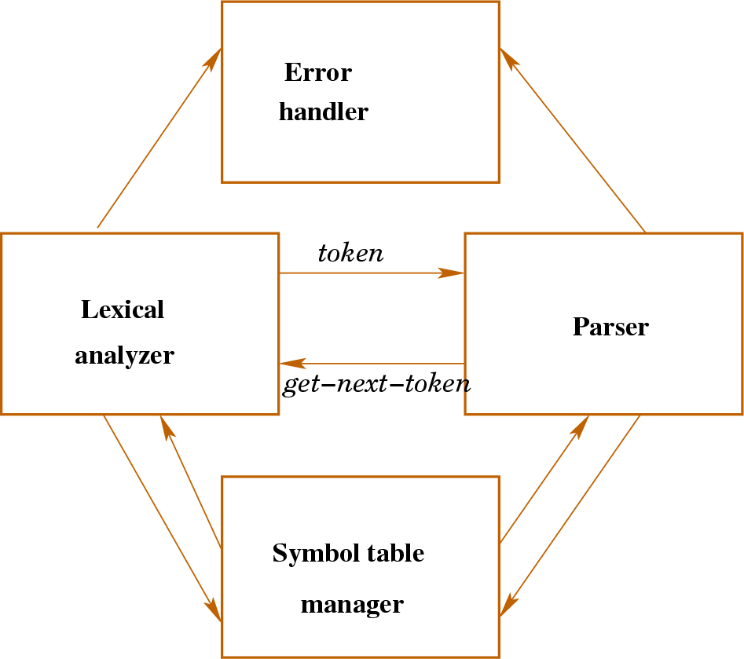

Slide 18
Continue..
Lexical Analyzer reads the source program character by character and returns the tokens of the source program.
Ex: newval = oldval + 12 => tokens: newval identifier
= assignment operator
oldval identifier
+ add operator
12 a number
For example, consider the program
int main()
{ // 2 variables int a, b; a = 10; return 0; }
Puts information about identifiers into the symbol table.
Regular expressions are used to describe tokens .
A (Deterministic) Finite State Automaton can be used in the implementation of a lexical analyzer.

Slide 19
Continue..
Finite state machine is used to recognize patterns.
Finite automata machine takes the string of symbol as input and changes its state accordingly. In the input, when a desired symbol is found then the transition occurs.
While transition, the automata can either move to the next state or stay in the same state.
FA has two states: accept state or reject state. When the input string is successfully processed and the automata reached its final state then it will accept.

Slide 20
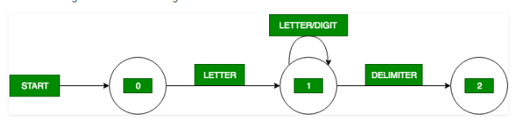
Continue..
Transition diagram is a special kind of flowchart for language analysis.
In transition diagram the boxes of flowchart are drawn as circle and called as states.
States are connected by arrows called as edges.

Slide 21
Continue..
Program segment code for each state :
State-0:
C=GETCHAR();
if LETTER(C) then goto State 1
else FAIL() //RETRACT the lookahead pointer or call error subroutine
State-1:
C=GETCHAR();
if LETTER(C) OR DIGIT(C) then goto State 1
else if DELIMITER(C) then goto State 2
else FAIL()
State-2:
RETRACT();
RETURN(ID, INSTALL())
Identifier has a value so to install the value of identifier in symbol table we use INSTALL()

Slide 22
Continue..
Count number of tokens :
int main()
{
int a = 10, b = 20;
printf("sum is :%d", a+b);
return 0;
}
Count number of tokens :
int max(int i);

Slide 23
Continue..
Lexical error: If the string fi is encountered in a C program for the first time in the context fi(a==f(x))
A lexical analyzer can not tell whether fi is a misspelling of keyword if or undeclared function identifier.
Since fi is a valid identifier
Lexical analyzer return the token for identifier and other phase of compiler handle the error.

Slide 24
Lex: A Lexical analyzer generator
Lex is a computer program that generates lexical analyzers.
Lex is commonly used with the yacc parser generator.
Lex has a language for describing regular expression.
It generate a pattern macther for the regular expression specifications provided to it as input.
The input notation for the Lex tool is referred to as the Lex language and tool itself is Lex compiler.
Lexical analyzer is prepared by creating a program lex.l in the Lex language. Then, lex.l is run through the Lex compiler to produce a C program lex.yy.c.
lex.yy.c is run through the C compiler to produce an object program a.out, which is the lexical analyzer that transforms an input stream into a sequence of tokens.

Slide 25
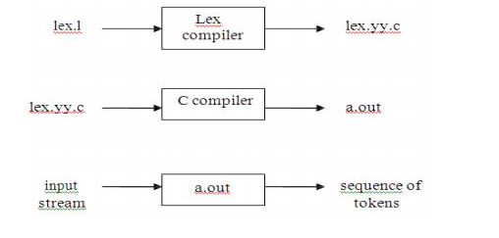
Continue..

Slide 26
Continue..
Lex Specification
A Lex program consists of three parts:
{ definitions } – opitional
{ rules } – essential
{ user subroutines } - essential
Commands to create a LA
lex file.l creates a C program lex.yy.c
type cc lex.yy.c –ll produce a.out
a.out is lexical analyzer that create token from input
Definitions include declarations of variables, constants, and regular definitions

Slide 27
Continue..
Rules are statements of the form
p₁ {action₁}
p₂ {action₂}
…
p_{n} {action_{n}}
where p_{i} is regular expression and action_{i} describes what action the lexical analyzer should take when pattern p_{i} matches a lexeme. Actions are written in C code.
User subroutines are auxiliary procedures needed by the actions. These can be compiled separately and loaded with the lexical analyzer.

Slide 28
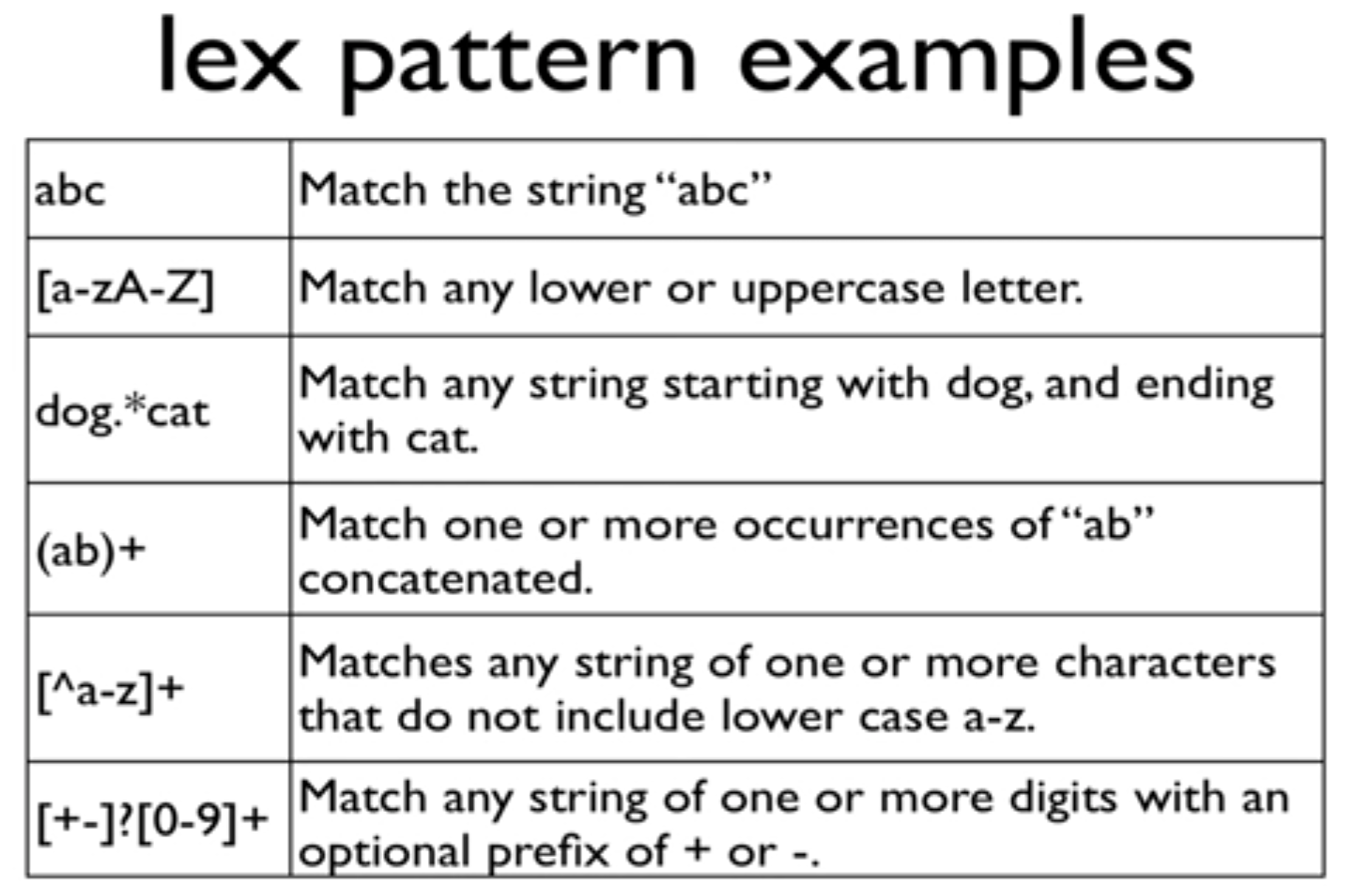

Slide 29
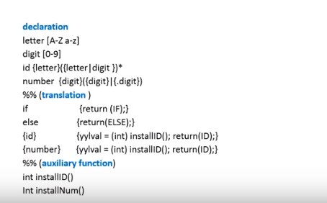
Program in lex

Slide 30
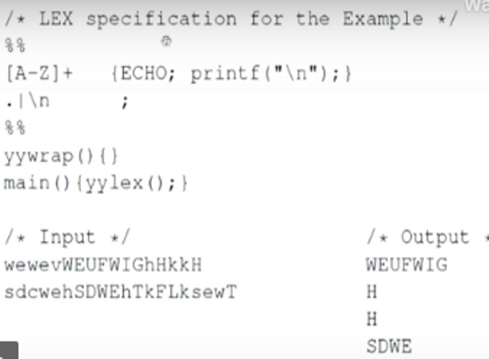

Slide 31
Rules
A line starting with white space or material enclosed in %{ and %} is c-code.
A line starting with anything else is a pattern line.
Patterns are regular expression
Pattern are translated into NFA which are then converted into DFA, optimized .
The action associated with a pattern is executed when DFA recognizes a string corresponding to that pattern and reaches at final state.

Slide 32
Syntax Analyzer
A Syntax Analyzer creates the syntactic structure (generally a parse tree) of the given program.
A syntax analyzer is also called as a parser.
Parser has two function:
It checks that the tokens appearing in its i/p, which is the o/p of lexical analyzer.
It also imposes on the tokens a tree like structure that is used by the subsequent phases of the compiler.
Example A+/B
This expression appear to the syntax analyzer as the sequence of token
id+/id

Slide 33
Continue..
Syntax analyzer detect an error on seeing /, because two adjacent binary operators violates the formulation rules of PL/I expression.
Second aspect of syntax analyzer is to identify which part of the token stream should be group together.
A/B*C
(a) divide A by B then multiply by C
(b) multiply B by C then use the result to divide A
Each of these two interpretation can be represented in terms of parse tree.
The language specification must tell us which of interpretations is to be used.
Syntax analyzer groups token together into syntactic structures.
Example: three token representing A+B might be grouped into syntactic structure called an expression.

Slide 34
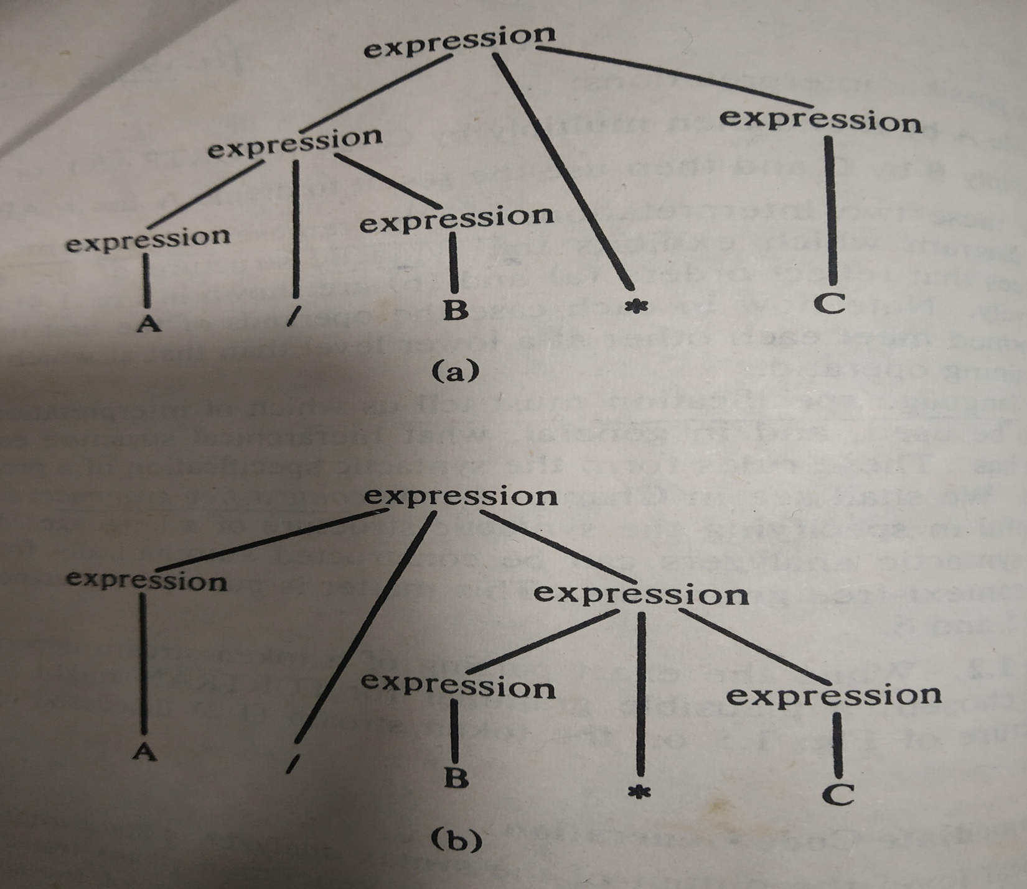

Slide 35
CFG
We provides the input in the syntax analyzer that is checked by grammar.
A context-free grammar (CFG) is a set of recursive rewriting rules (or productions) used to generate patterns of strings.
A context-free grammar is define with the help of 4-tuple
G=(V, T, P, S)
V is the finite set of nonterminal symbols, Nonterminals in CFG are also known as variables. It represents by capital letters of alphabets, for example; A, B, …. X, Y etc.
T is a finite set of terminal symbols
P is a finite set of productions rules, which are the rules for replacing nonterminal symbols in a string with other nonterminal or terminal symbols

Slide 36
Continue..
In CFG every production rule is of the form A→α, where A is a non-terminals and α is a sequence of non-terminals and terminals.
S ∈ is a start symbol, which is a special nonterminal symbol that appears in the initial string generated by the grammar.
E->E+E V={E}, T={+, *, id}
/E*E
/id
Main objective of grammar is to generate the string
id+id*id

Slide 37
E->E+E V={E}, T={+, *, id}
/E*E
/id
LMD RMD
E=>E+E E=>E+E
=>id+E =>E+E*E
=>id+E*E =>E+E*id
=>id+id*E =>E+id*id
=>id+id*id =>id+id*id

Slide 38
Syntax Analyzer
A parse tree describes a syntactic structure.
assgstmt
identifier := expression
newval expression + expression
identifier number
oldval 12
In a parse tree, all terminals are at leaves.

Slide 39
Syntax Analyzer (CFG)
The syntax of a language is specified by a context free grammar (CFG).
The rules in a CFG are mostly recursive.
A syntax analyzer checks whether a given program satisfies the rules implied by a CFG or not.
If it satisfies, the syntax analyzer creates a parse tree for the given program.

Slide 40
Syntax Analyzer versus Lexical Analyzer
Which constructs of a program should be recognized by the lexical analyzer, and which ones by the syntax analyzer?
The lexical analyzer simplifies the job of the syntax analyzer.
The lexical analyzer recognizes the smallest meaningful units (tokens) in a source program.
The syntax analyzer works on the smallest meaningful units (tokens) in a source program to recognize meaningful structures in our programming language.

Slide 41
Parsing Techniques
Depending on how the parse tree is created, there are different parsing techniques.
These parsing techniques are categorized into two groups:
Top-Down Parsing,
Bottom-Up Parsing
Top-Down Parsing:
Construction of the parse tree starts at the root, and proceeds towards the leaves.
Efficient top-down parsers can be easily constructed by hand.
Recursive Predictive Parsing, Non-Recursive Predictive Parsing (LL Parsing).
Bottom-Up Parsing:
Construction of the parse tree starts at the leaves, and proceeds towards the root.
Normally efficient bottom-up parsers are created with the help of some software tools.
Bottom-up parsing is also known as shift-reduce parsing.
Operator-Precedence Parsing – simple, restrictive, easy to implement
LR Parsing – much general form of shift-reduce parsing, LR, SLR, LALR

Slide 42
Top down parsing
The process of construction of parse tree starting from root & proceed to children is called TDP, it is starting from start symbol of grammar and reaching the i/p string. It follows leftmost derivation
S->aABc
A->bc
B->d
string s=abcde

Slide 43
Bottom up parsing
Build the parse tree from leaves to root. Bottom up parsing can be defined as an attempt to reduce the input string w to the start symbol of grammar by tracing out the right most derivation of w in reverse.
S->aABe
A->Abc/b
B->d
input:abbcde

Slide 44
YACC: Yet Another Compiler-Compiler
Yacc generates C code for syntax analyzer, of parser.
• Yacc uses grammar rules that allow it to analyze tokens from LEX and create a syntax tree.
Yacc provides a general tool for describing the input to a computer program.
• Yacc is written in portable C.
Yacc is a computer program for the Unix operating system.
• It is a Look Ahead Left-to-Right (LALR) parser generator, generating a parser

Slide 45
Continue..
YACC translates a given Context Free Grammar (CFG) specifications (input in input_file.y) into a C implementation (y.tab.c) of a corresponding push down automaton.
Yacc reads the grammar descriptions in yacc.y and generates a syntax analyzer (parser), that includes function yyparse, in file y.tab.c.
The -d option causes yacc to generate definitions for tokens and place them in file y.tab.h.
Lex reads the pattern descriptions in lex.l, includes file y.tab.h, and generates a lexical analyzer, function yylex, in file lex.yy.c.
Finally, the lexer and parser are compiled and linked together to create executable .exe.
From main we call yyparse to run the compiler. Function yyparse automatically calls yylex to obtain each token.

Slide 46
Yacc Program to evaluate a given arithmetic expression
Problem: Write a YACC program to evaluate a given arithmetic expression consisting of ‘+’, ‘-‘, ‘*’, ‘/’ including brackets.
Examples:
Input: 7*(5-3)/2 Output: 7
Input: 6/((3-2)*(-5+2)) Output: -2

Slide 47
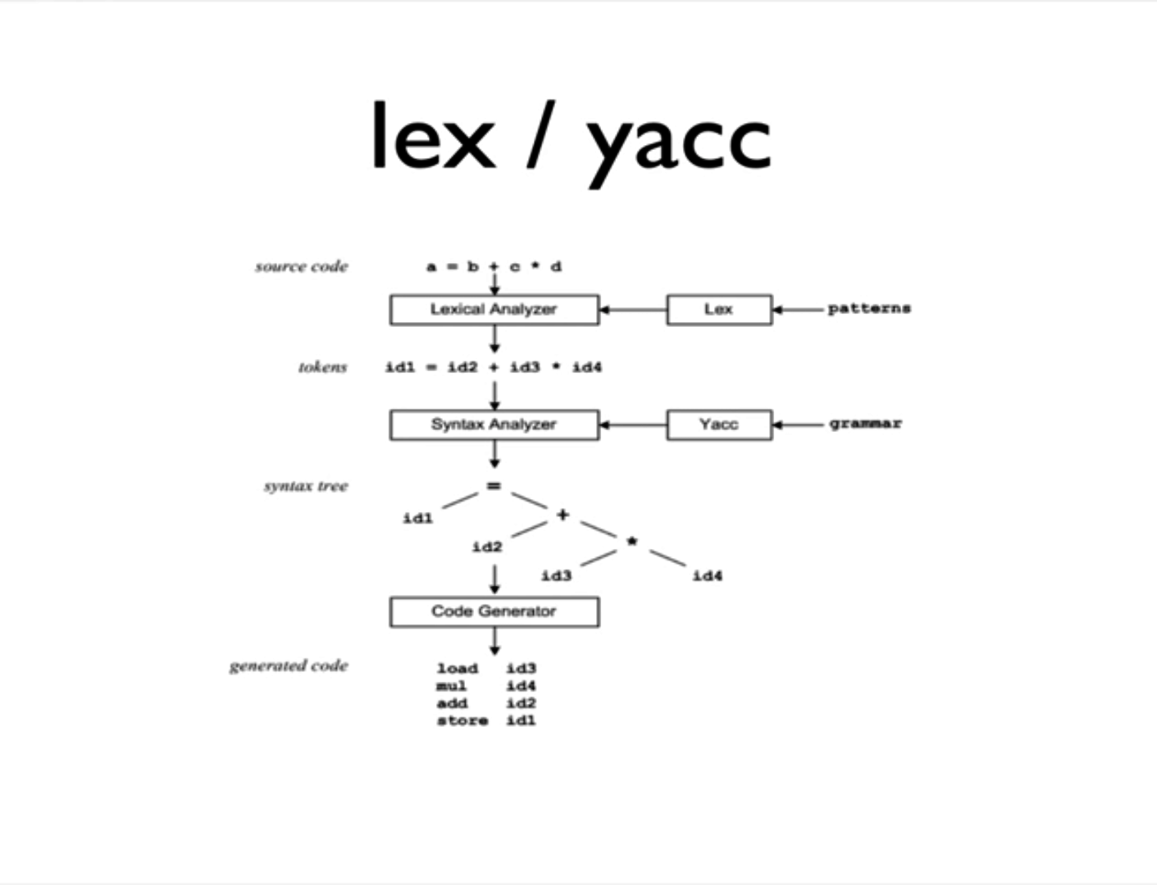

Slide 48
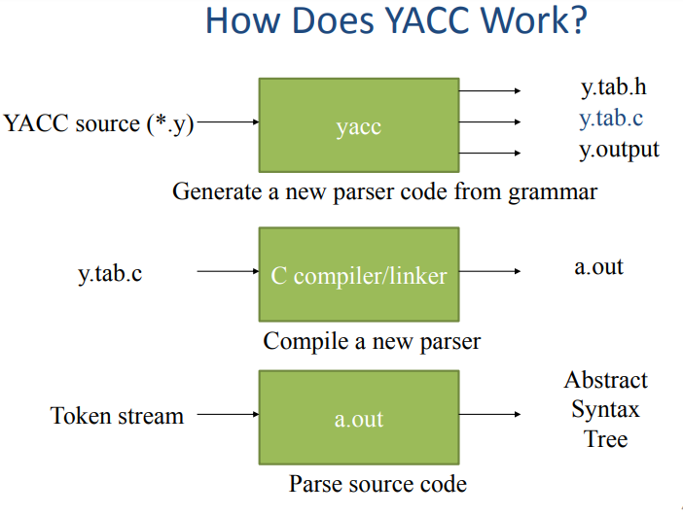

Slide 49
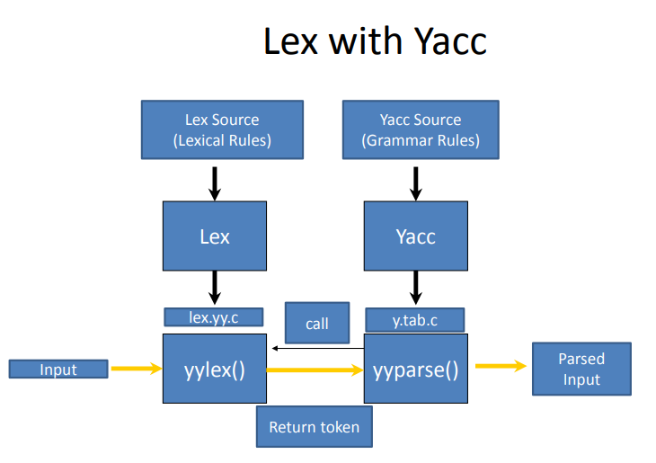

Slide 50
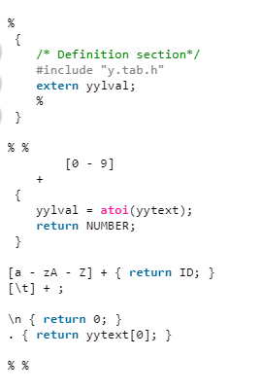
Lex code

Slide 51
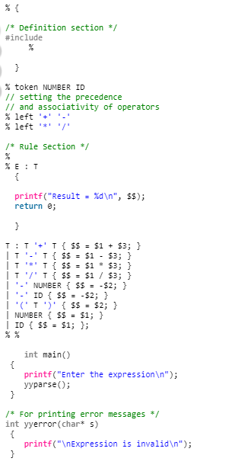
Yacc code

Slide 52
Running a Lex and Yacc program
Commands to run YACC with Lex
for compiling lex and yacc together
1. write lex program in a file file.l and yacc in a file file.y
2. open the terminal and navigate to the directory where you have saved the files.
3. type lex file.l
4. type yacc –d file.y
5. type cc lex.yy.c y.tab.h -ll
6. type ./a.out

Slide 53
Semantic Analyzer
A semantic analyzer checks the source program for semantic errors and collects the type information for the code generation.
Type-checking is an important part of semantic analyzer.
Normally semantic information cannot be represented by a context-free language used in syntax analyzers.
Context-free grammars used in the syntax analysis are integrated with attributes (semantic rules)
the result is a syntax-directed translation,
Attribute grammars
Ex:
newval := oldval + 12
The type of the identifier newval must match with type of the expression (oldval+12)

Slide 54
Intermediate Code Generation
A compiler may produce an explicit intermediate codes representing the source program.
These intermediate codes are generally machine (architecture independent). But the level of intermediate codes is close to the level of machine codes.
Ex:
newval := oldval * fact + 1
id1 := id2 * id3 + 1
MULT id2,id3,temp1 Intermediates Codes (Quadraples)
ADD temp1,#1,temp2
MOV temp2,,id1

Slide 55
Code Optimizer (for Intermediate Code Generator)
The code optimizer optimizes the code produced by the intermediate code generator in the terms of time and space.
Ex:
MULT id2,id3,temp1
ADD temp1,#1,id1

Slide 56
Code Generator
Produces the target language in a specific architecture.
The target program is normally is a relocatable object file containing the machine codes.
Ex:
( assume that we have an architecture with instructions whose at least one of its operands is
a machine register)
MOVE id2,R1
MULT id3,R1
ADD #1,R1
MOVE R1,id1

